Slide 1

Why try ?
Advantages of this beautiful language
Xopre Rodríguez Gallego
15/07/25, Universidad de Sevilla

Slide 2
The Basics
As expected

Slide 3
The basics
Open-source programming language
Graphics and statistical computations
Data storage & analysis
Generation of statistical models

Slide 4
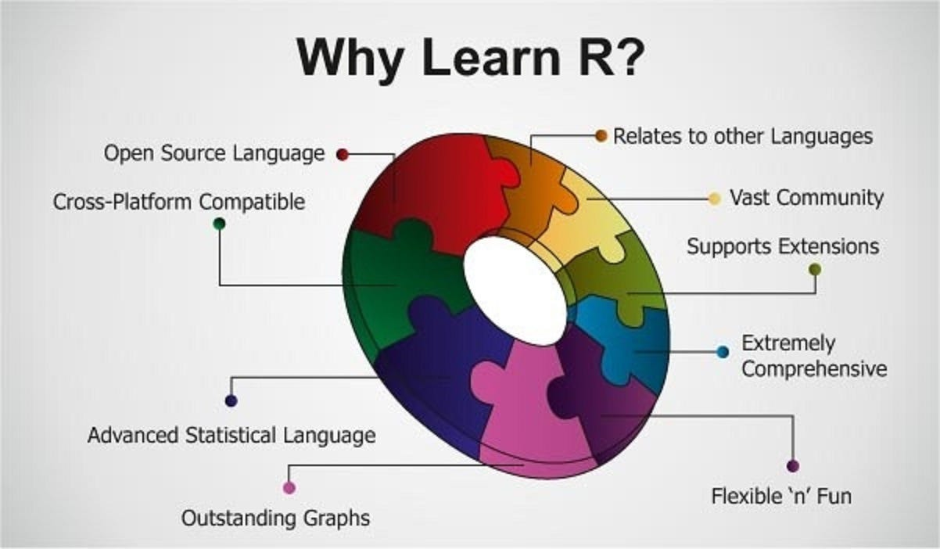
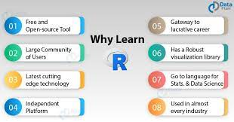

Slide 5


Slide 6
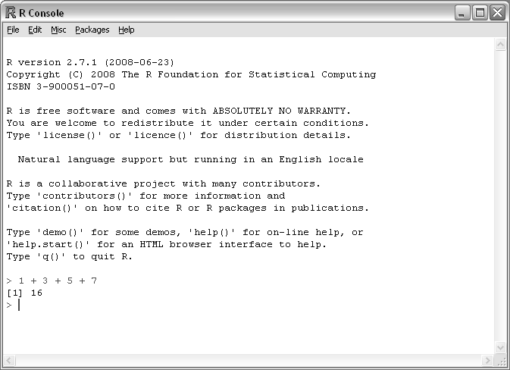

Slide 7
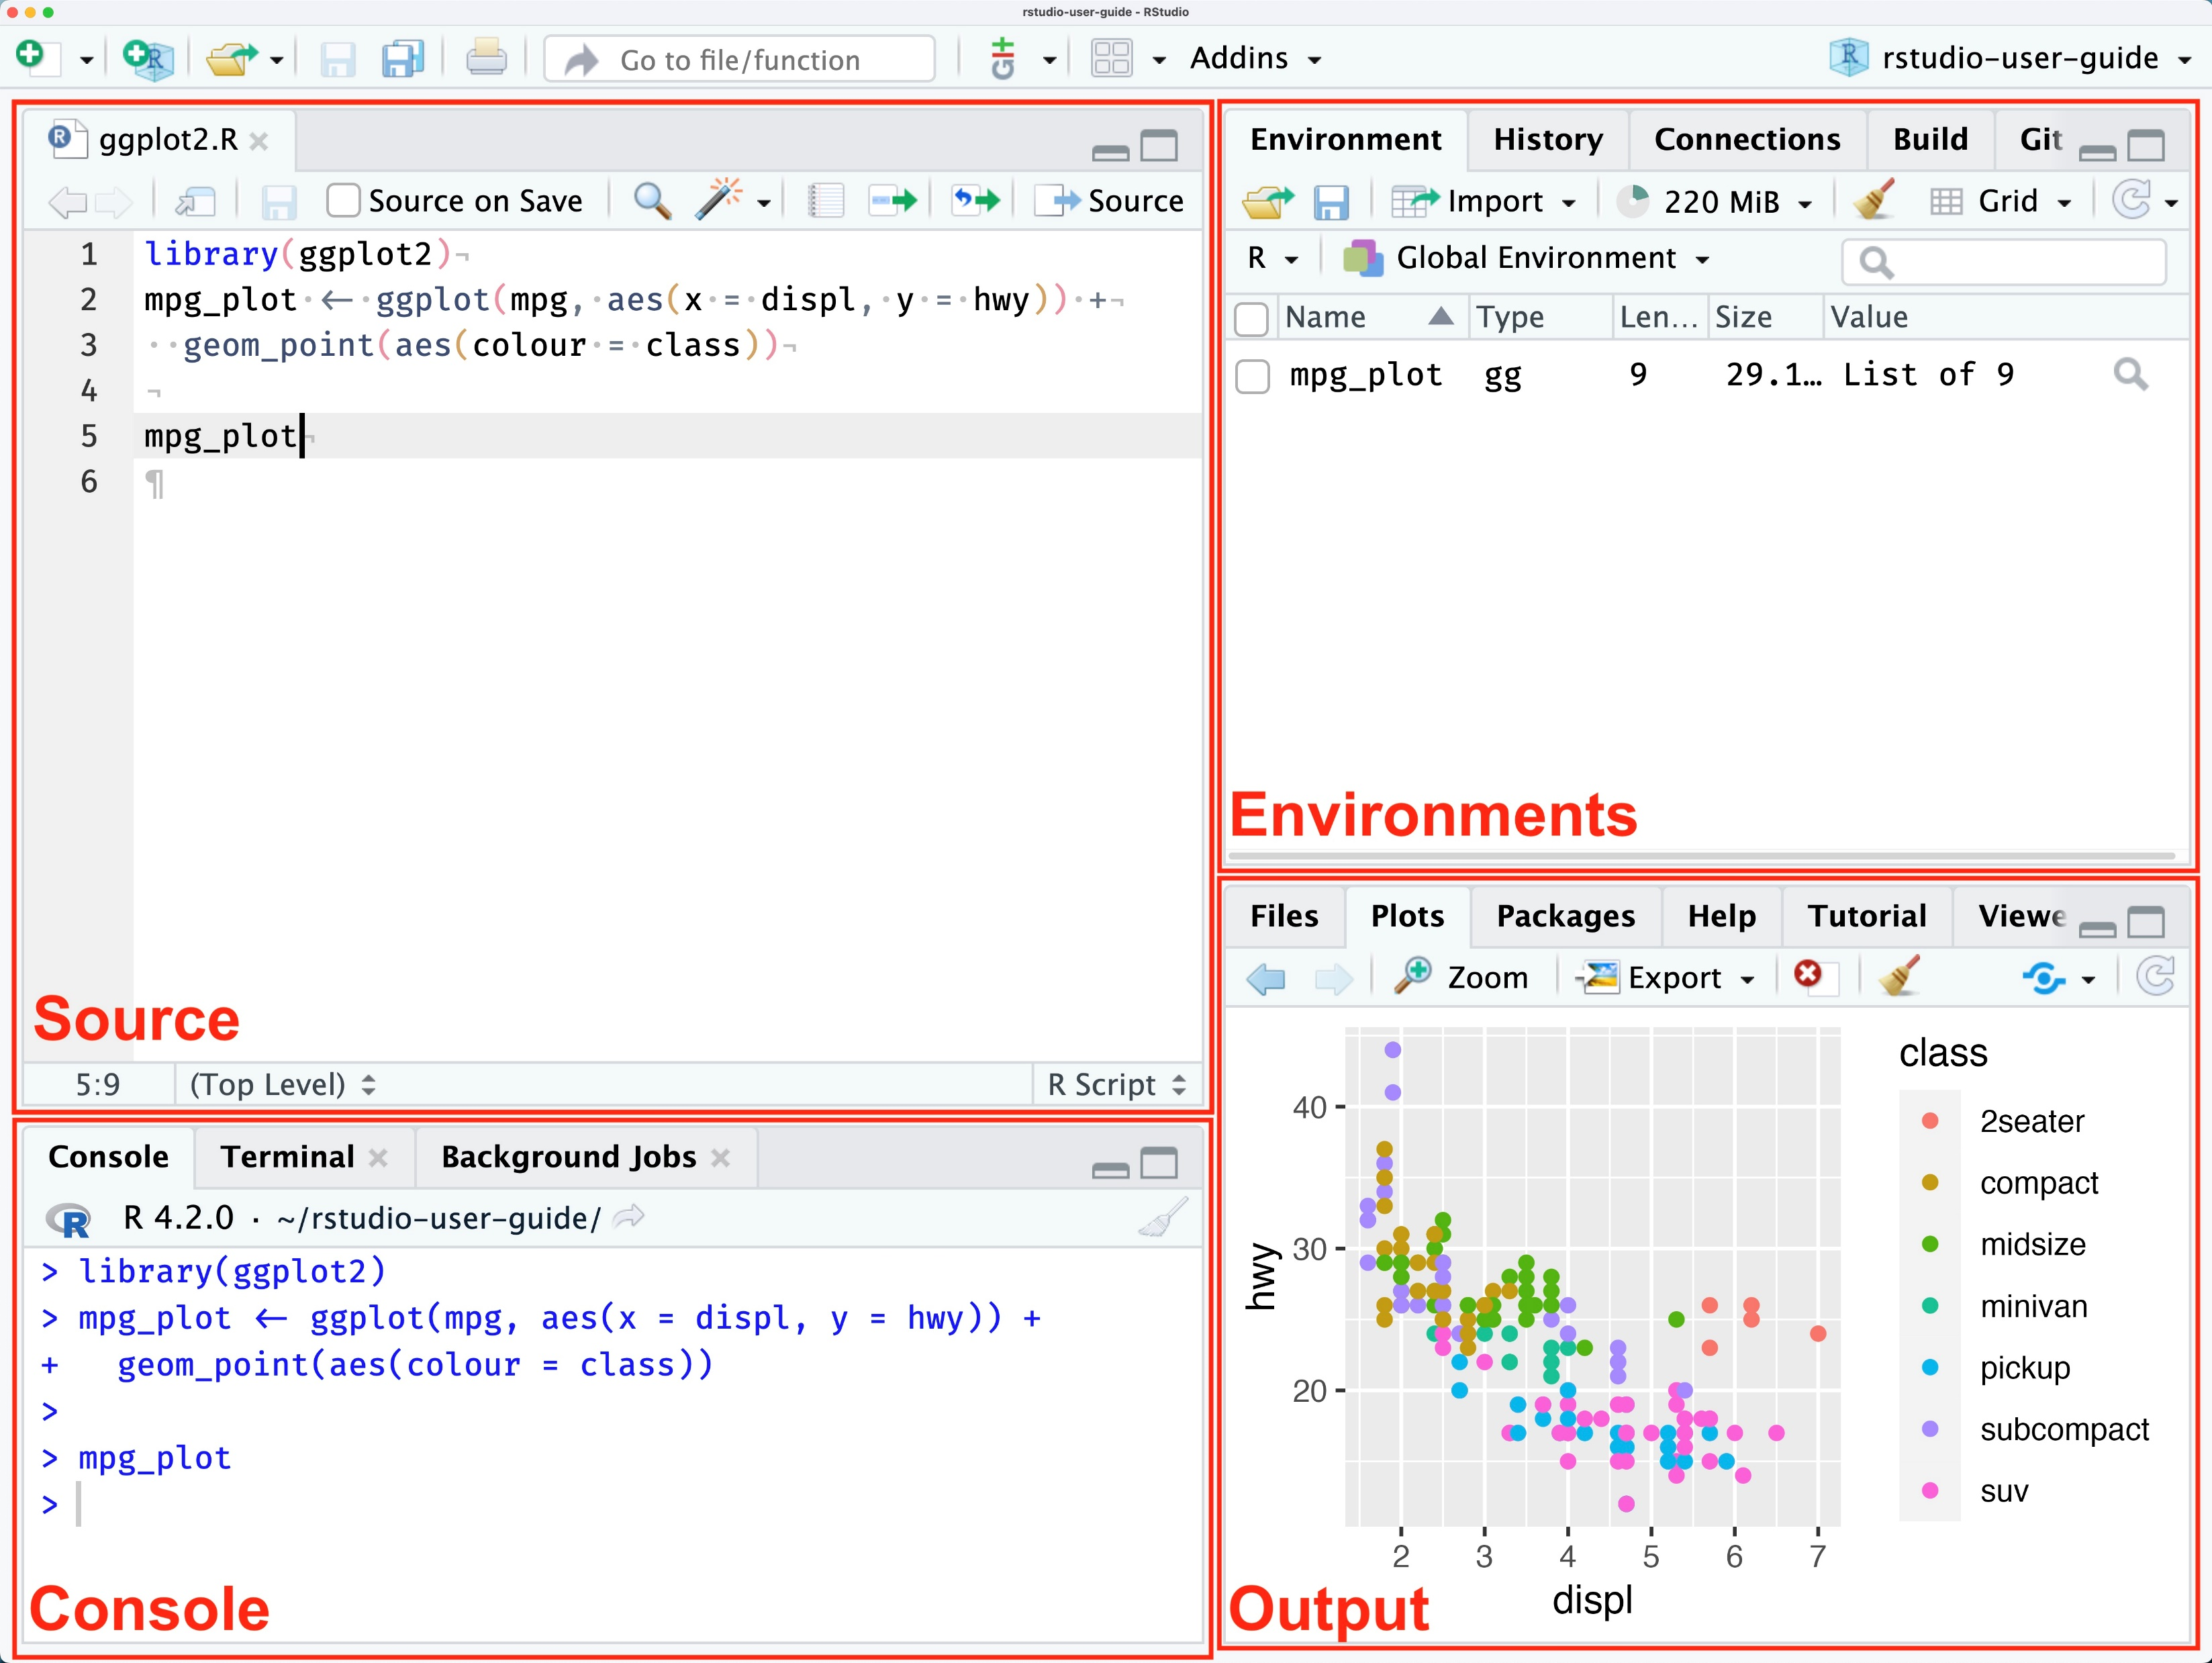

Slide 8
Code readability
The pipe operator: %>%

Slide 9
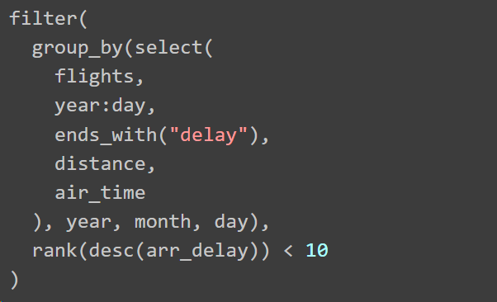
R before the pipe

Slide 10
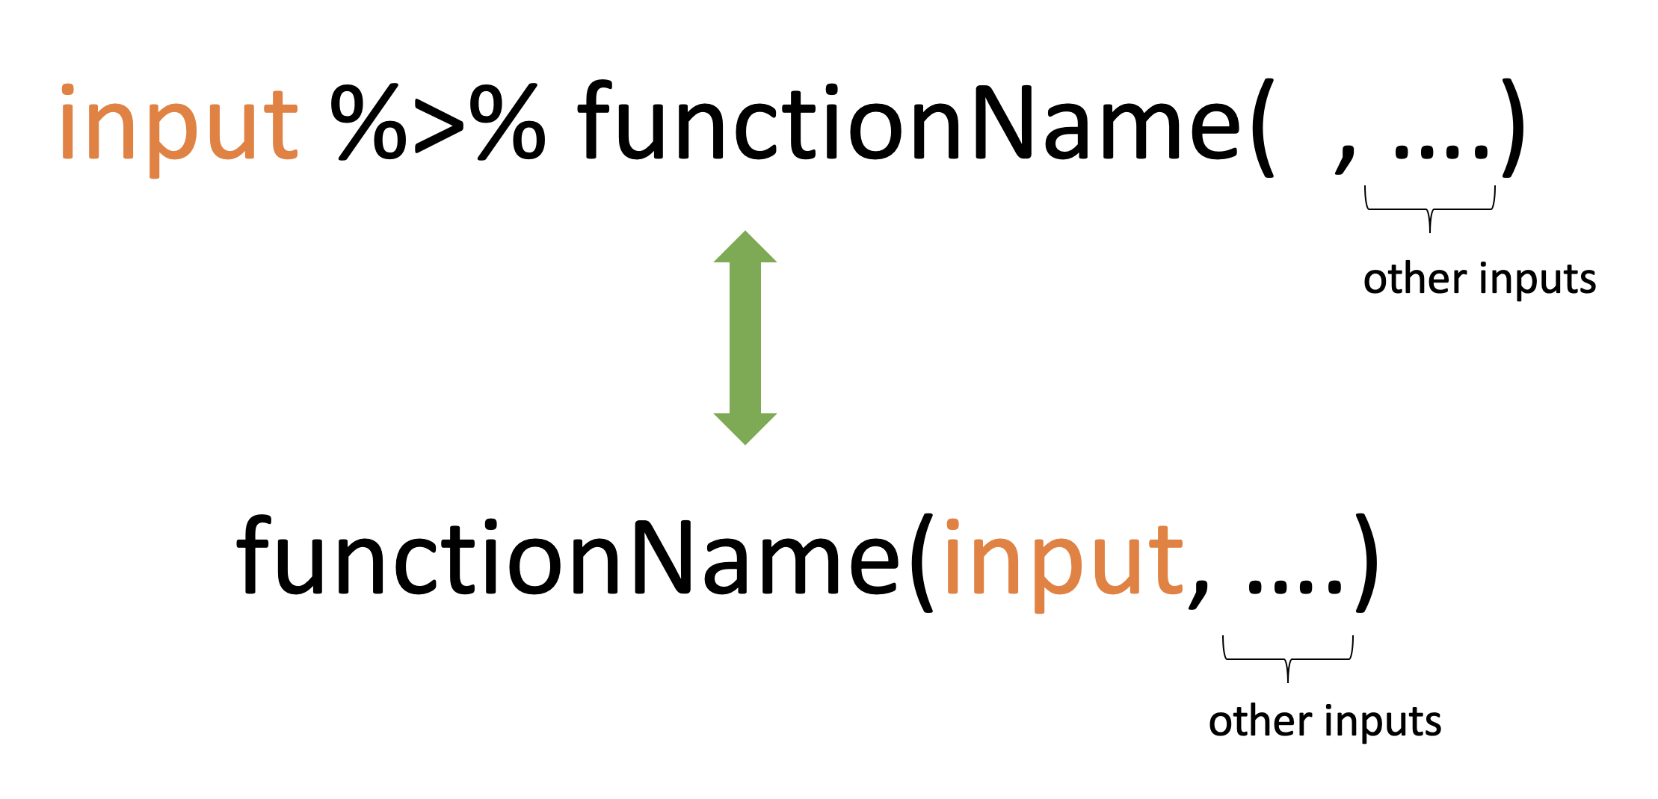
The pipe operator

Slide 11
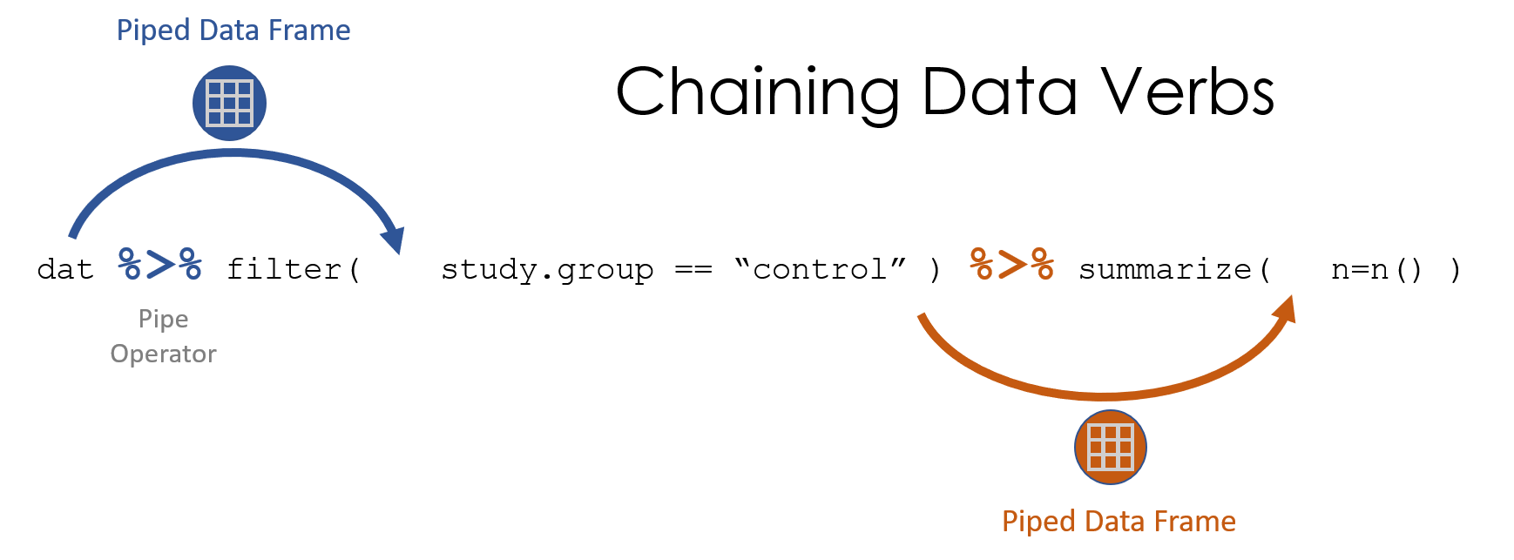
The pipe operator

Slide 12
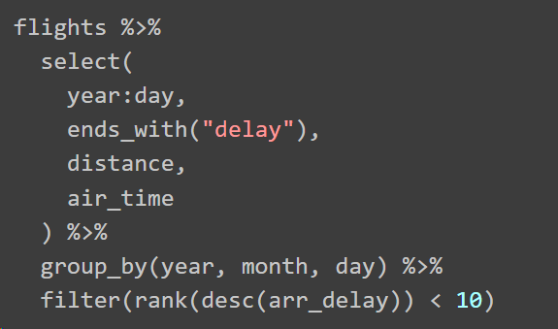
R after the pipe

Slide 13
Adaptability
A whole universe of packages

Slide 14
Common packages
https://cran.r-project.org/web/packages/available_packages_by_name.html
All of them open sourced (GitHub/CRAN) to some extent
Data cleaning and visualization, machine learning, app development and deployment…

Slide 15
Usual workflow
Data analysis

Slide 16
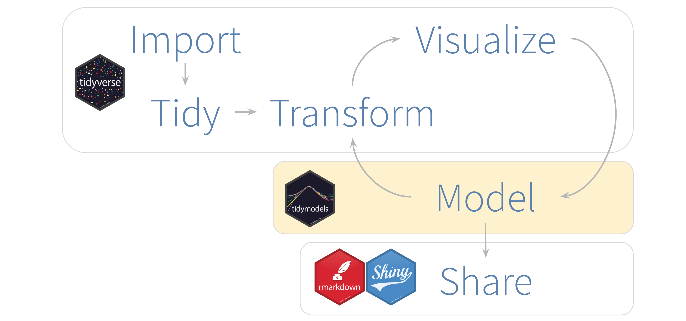

Slide 17
The tidyverse framework
"share an underlying design philosophy, grammar, and data structures" of tidy data

Slide 18
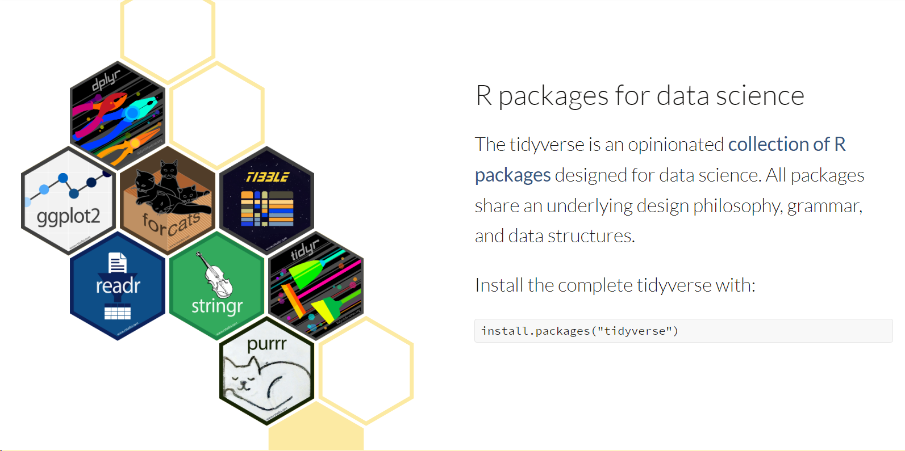

Slide 19
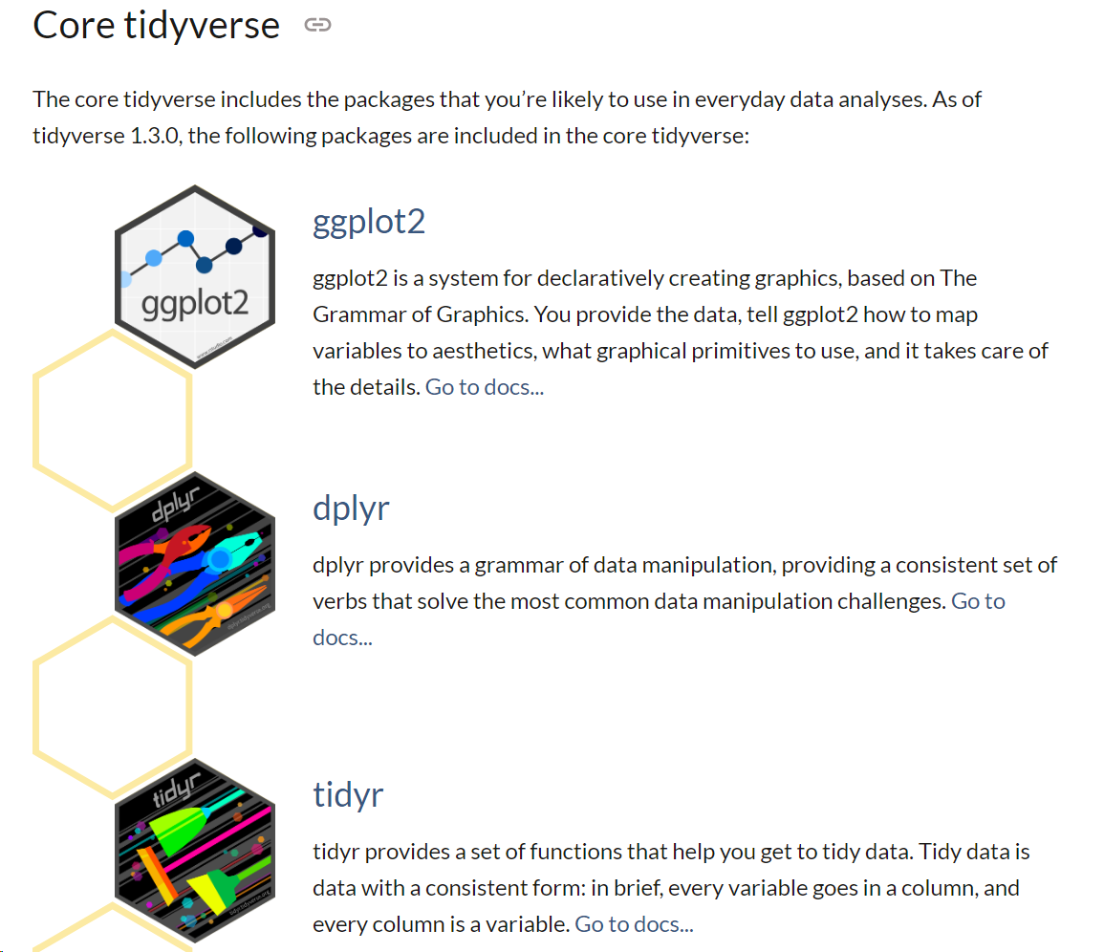

Slide 20
ggplot2 examples

Slide 21
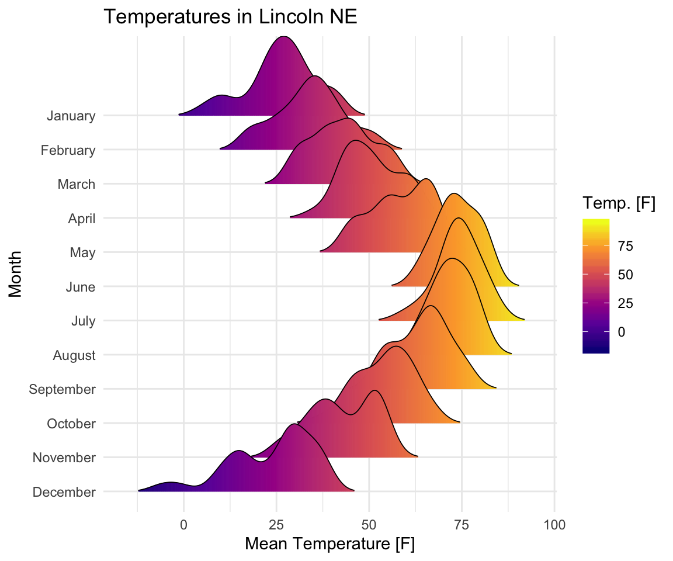

Slide 22
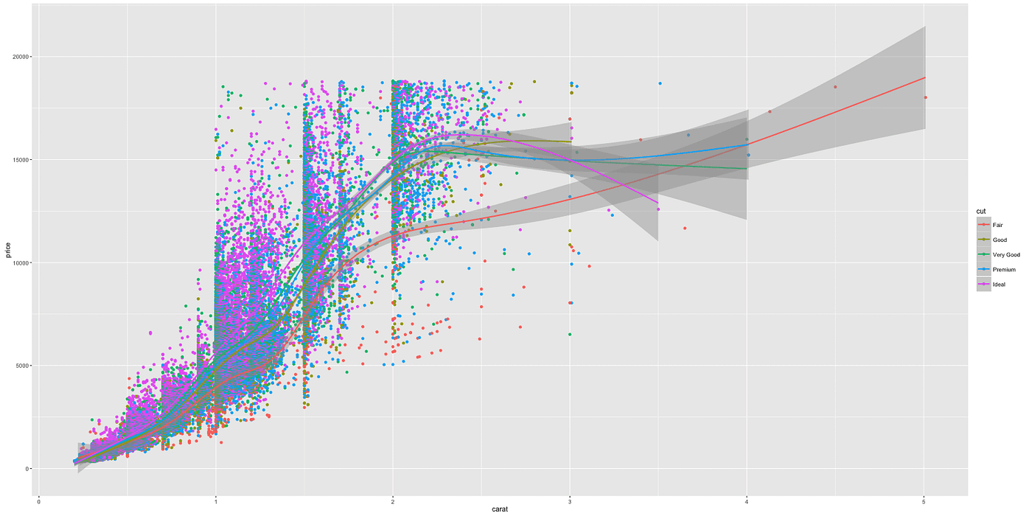

Slide 23
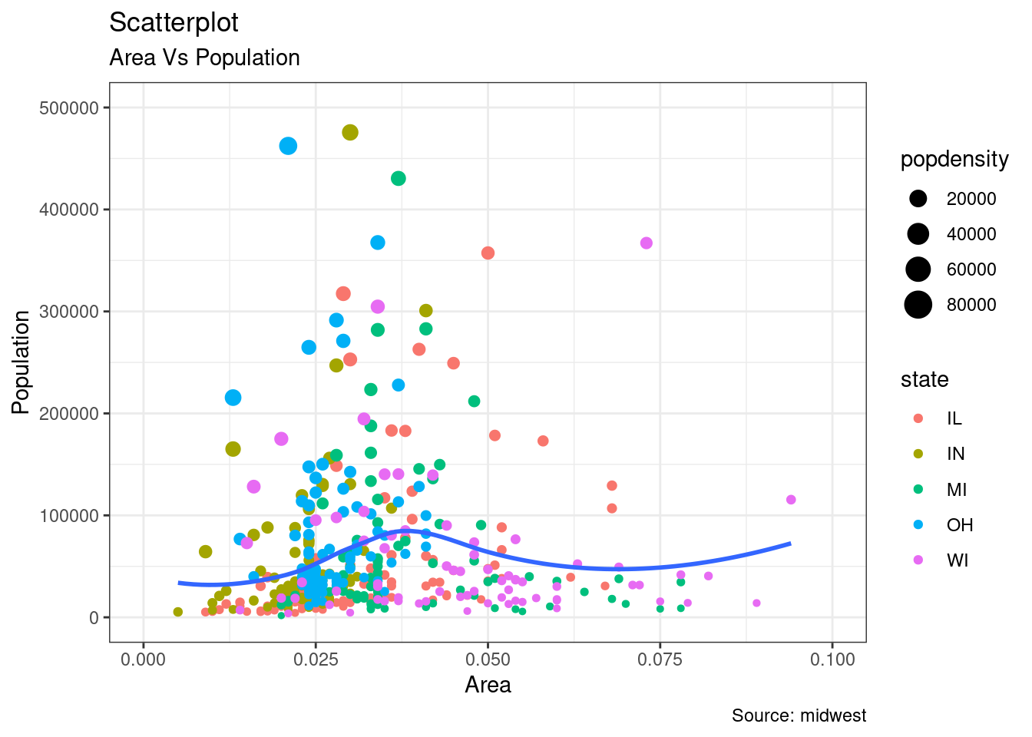

Slide 24
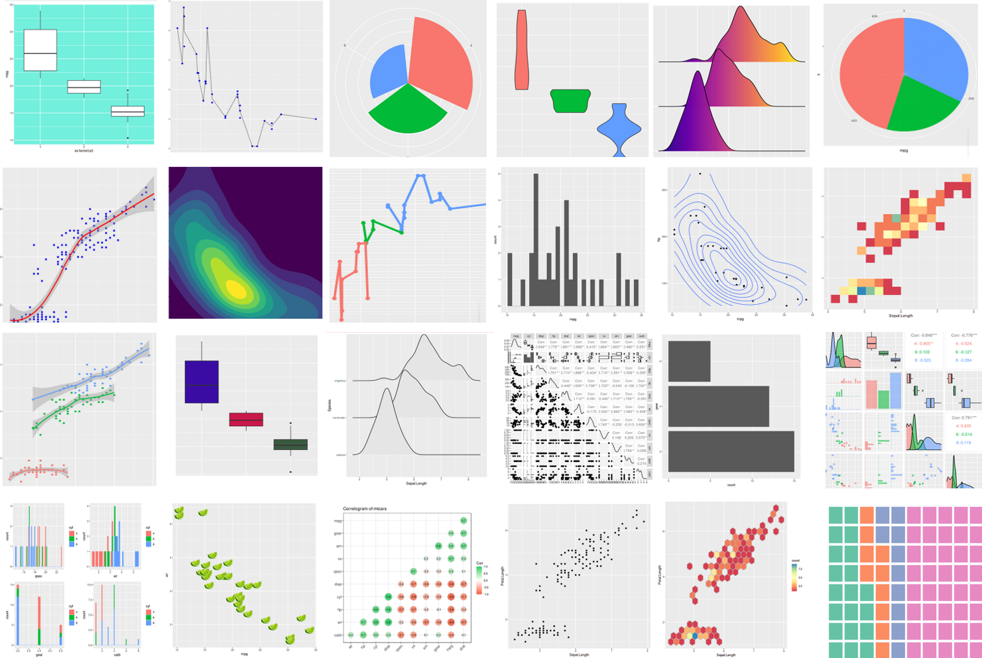

Slide 25
Other packages
In the tidyverse framework

Slide 27
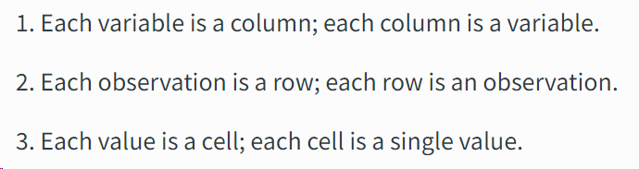
Tidy data

Slide 28




Slide 29
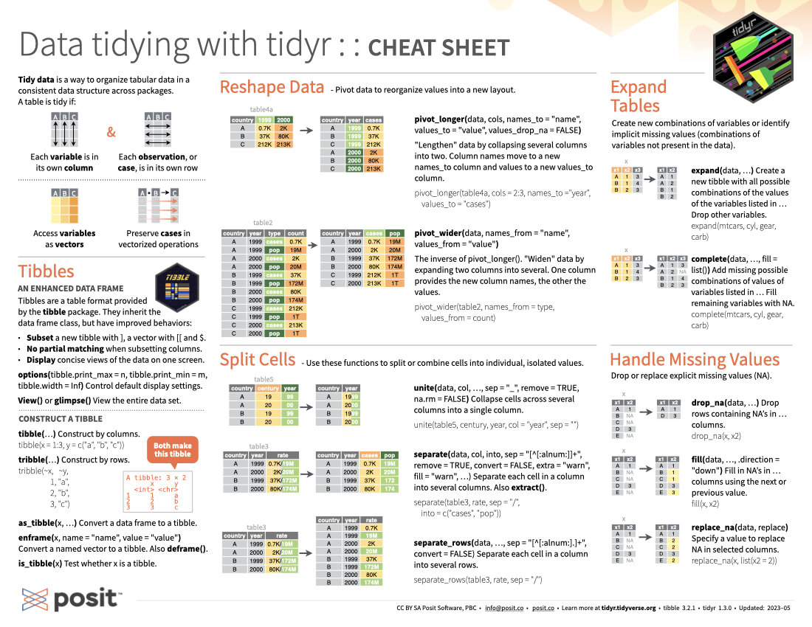
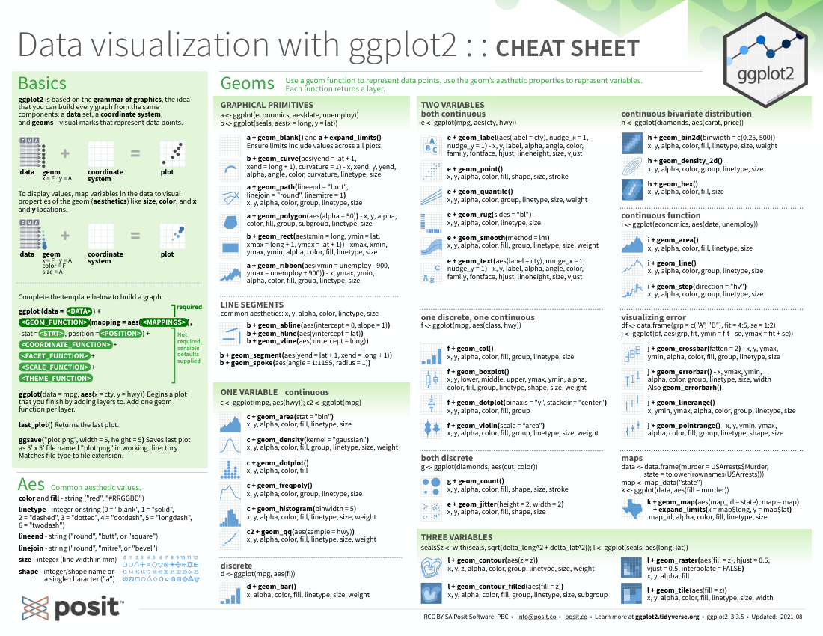
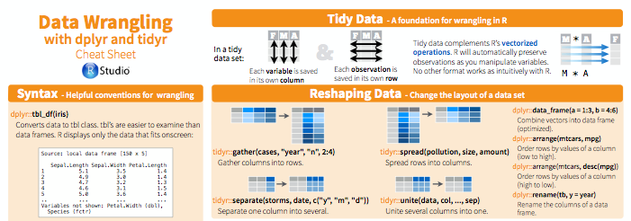
Cheat sheets

Slide 30
The tidymodels framework
“modeling and machine learning using tidyverse principles”

Slide 31
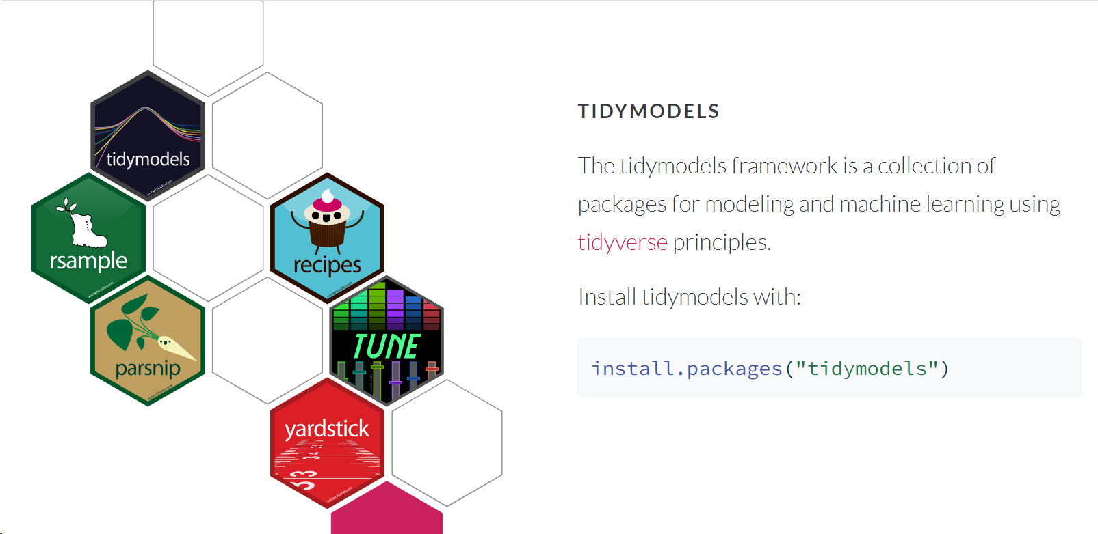

Slide 32
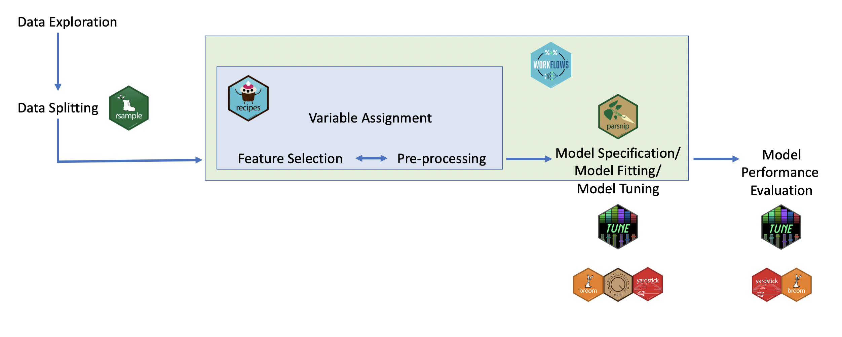
tidymodels workflow

Slide 33
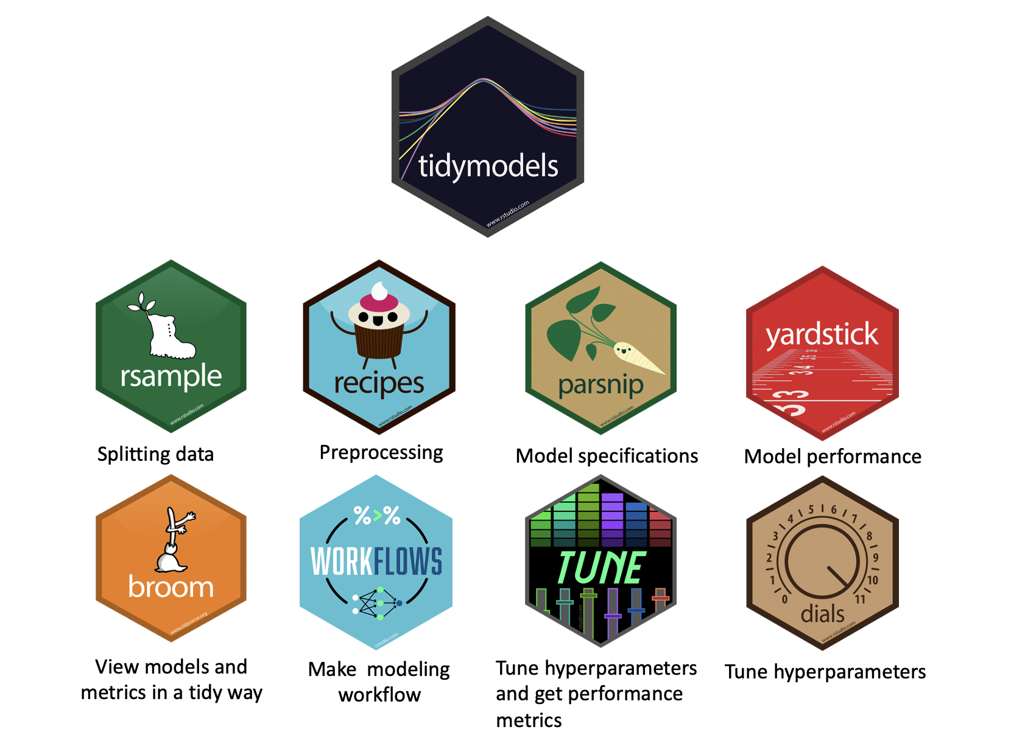

Slide 34
A million outputs
The Rmarkdown package

Slide 35
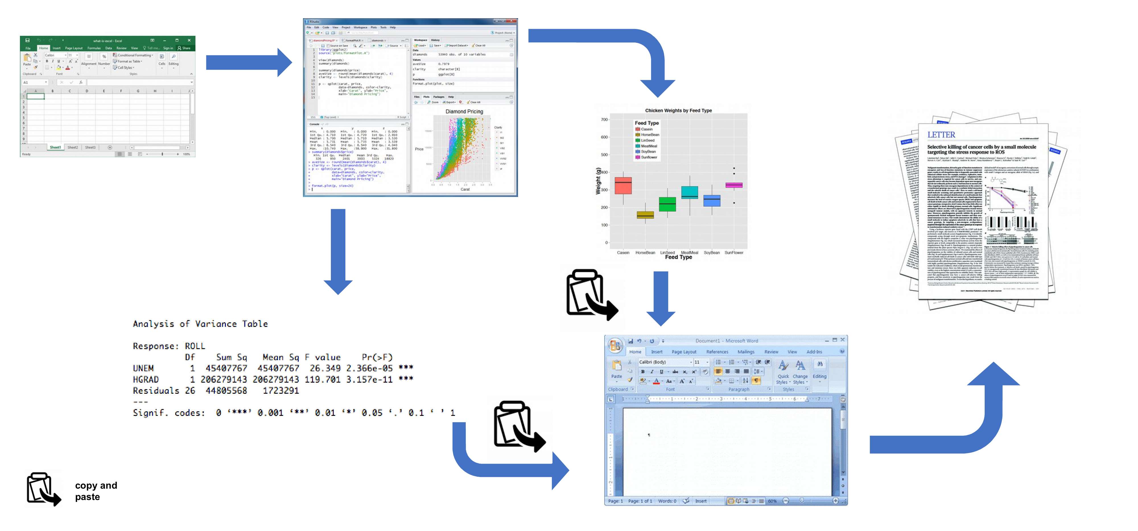
The usual approach

Slide 36
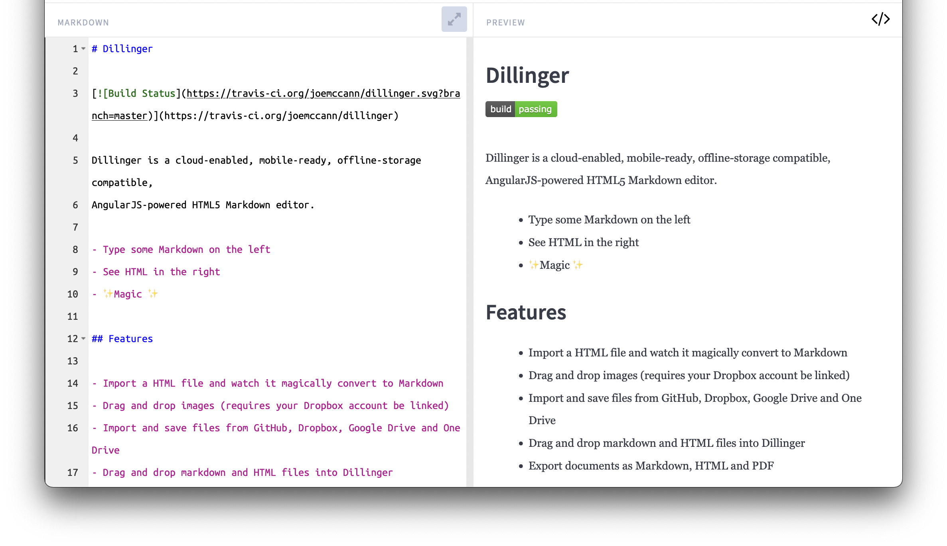
What is markdown?

Slide 37
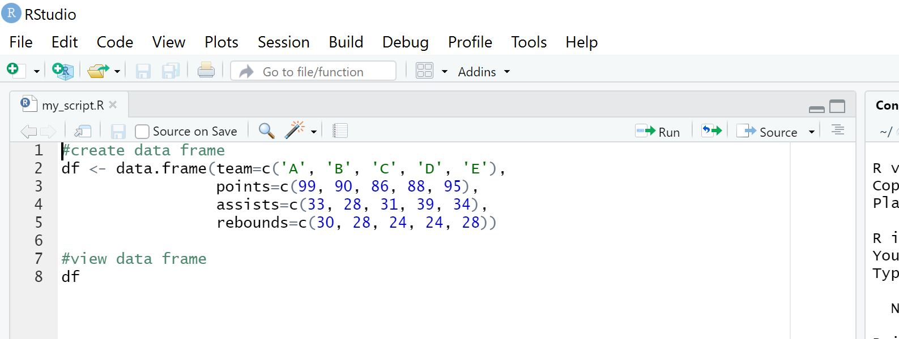

Slide 38
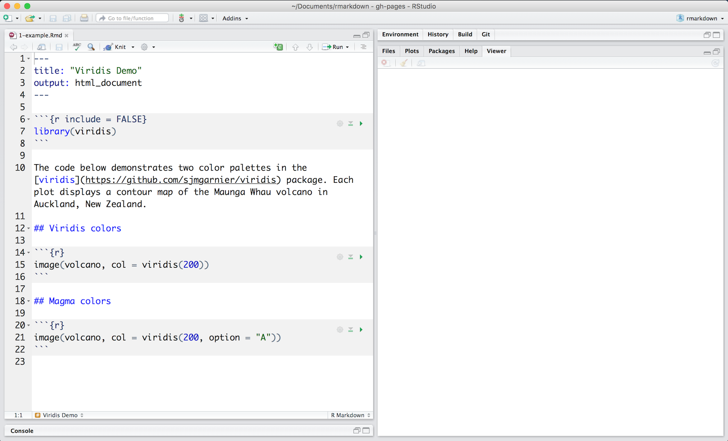

Slide 39
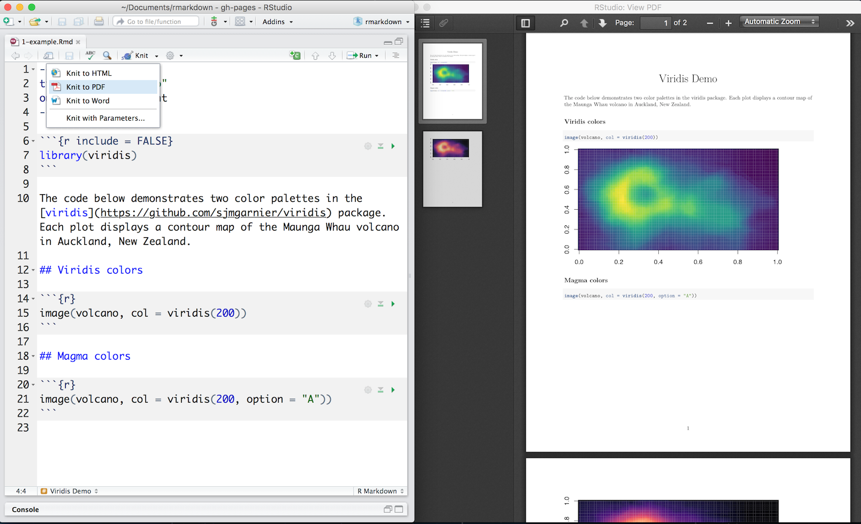

Slide 40
Output options
Documents
html_notebook - Interactive R Notebooks
html_document - HTML document w/ Bootstrap CSS
pdf_document - PDF document (via LaTeX template)
word_document - Microsoft Word document (docx)
odt_document - OpenDocument Text document
rtf_document - Rich Text Format document
md_document - Markdown document (various flavors)
Presentations (slides)
ioslides_presentation - HTML presentation with ioslides
revealjs::revealjs_presentation - HTML presentation with reveal.js
slidy_presentation - HTML presentation with W3C Slidy
beamer_presentation - PDF presentation with LaTeX Beamer
powerpoint_presentation: PowerPoint presentation
More
flexdashboard::flex_dashboard - Interactive dashboards
tufte::tufte_handout - PDF handouts in the style of Edward Tufte
tufte::tufte_html - HTML handouts in the style of Edward Tufte
tufte::tufte_book - PDF books in the style of Edward Tufte
html_vignette - R package vignette (HTML)
github_document - GitHub Flavored Markdown document
You can also build books, websites, web applications, and interactive documents with R Markdown.

Slide 41
Other stuff
Still interesting

Slide 42
Other stuff
posit::conf(2024)
AIs: GitHub Copilot, ChatGPT
Active community

Slide 43
Why try ?
Advantages of this beautiful language
Xopre Rodríguez Gallego
15/07/25, Universidad de Sevilla

